Slide 1
JavaScript ES6
COURSE OVERVIEW

Slide 3
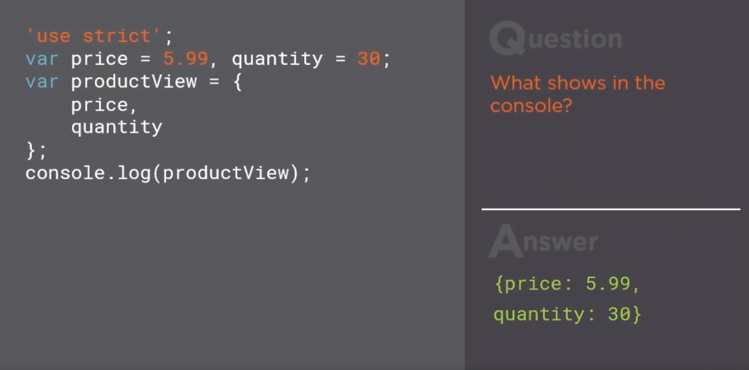

Slide 5
